Slide 1
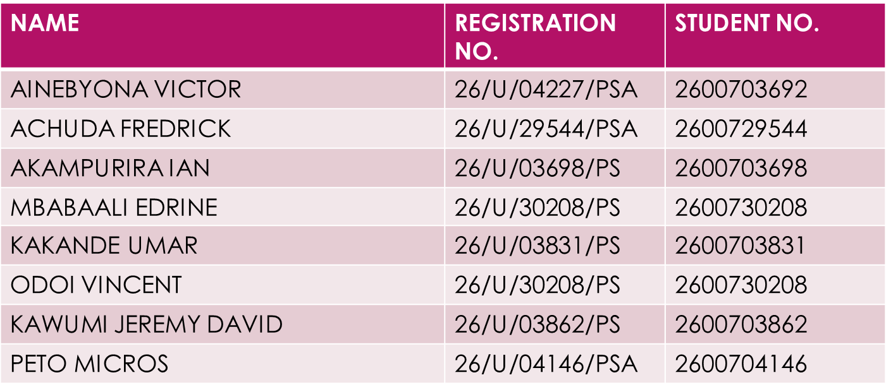
COURSE UNIT: MATHS IST 1106 SEMESTER:1 LECTURER: BYANSI DAVID GROUP: D

Slide 2
RATIOS AND PROPORTIONS
Ratio; a ratio is a mathematical comparison between two or more quantities to show how one much one is, compared to the other.
Proportion; this is a mathematical statement that shows a relationship between two or more quantities.
types of proportions are; direct and indirect proportions

Slide 3
Direct proportion
In direct proportion an increase in one quantity leads to an increase in the other.
QN 1 consider a car uses 12 litres of petrol to travel 180 kilometres. how many litres of petrol are needed to travel 300 kilometres.
First(is the qn. Indirect or direct) For this its direct;?? Cause increase in no. of litres of petrol leads to increase in distance travelled.
So therefore let the litres of petrol used be y and kilometres be x, so y is directly proportional to x

Slide 4
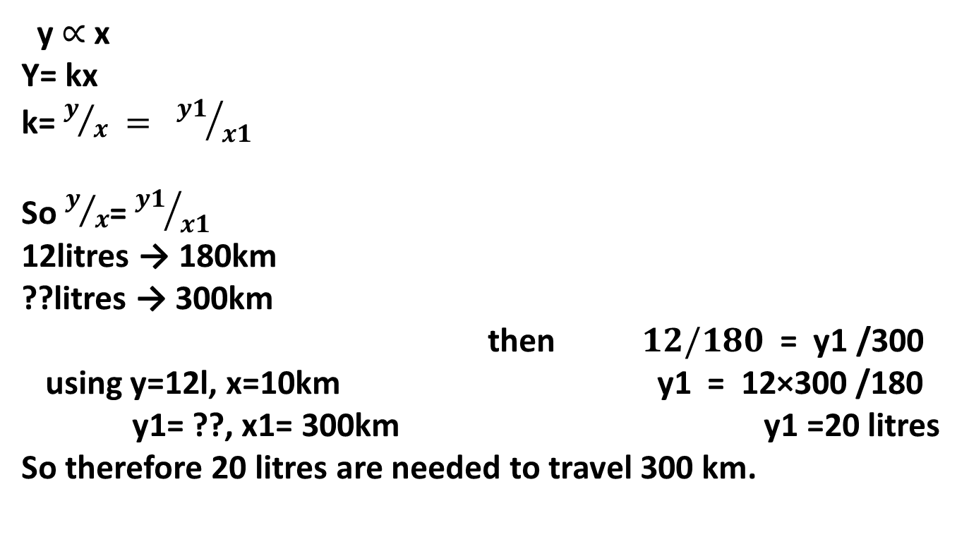
Qn 1 solution
y $∝$ x
Y= kx
k= $y/x = {y1}/{x1}$
So $y/x$= ${y1}/{x1}$
12litres → 180km
??litres → 300km
then $12/180$ = y1 /300
using y=12l, x=10km y1 = 12×300 /180
y1= ??, x1= 300km y1 =20 litres
So therefore 20 litres are needed to travel 300 km.

Slide 5
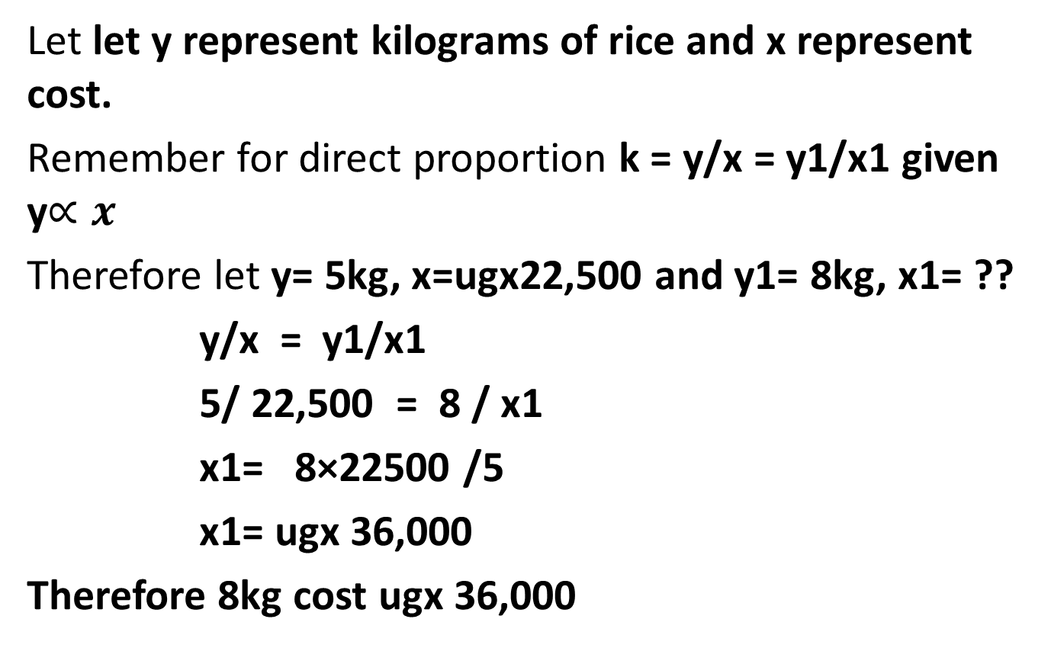
Qn 2. If 5 kilograms of rice cost UgX 22,500 how much will8kg cost?
Let let y represent kilograms of rice and x represent cost.
Remember for direct proportion k = y/x = y1/x1 given y$∝x$
Therefore let y= 5kg, x=ugx22,500 and y1= 8kg, x1= ??
y/x = y1/x1
5/ 22,500 = 8 / x1
x1= 8×22500 /5
x1= ugx 36,000
Therefore 8kg cost ugx 36,000

Slide 6
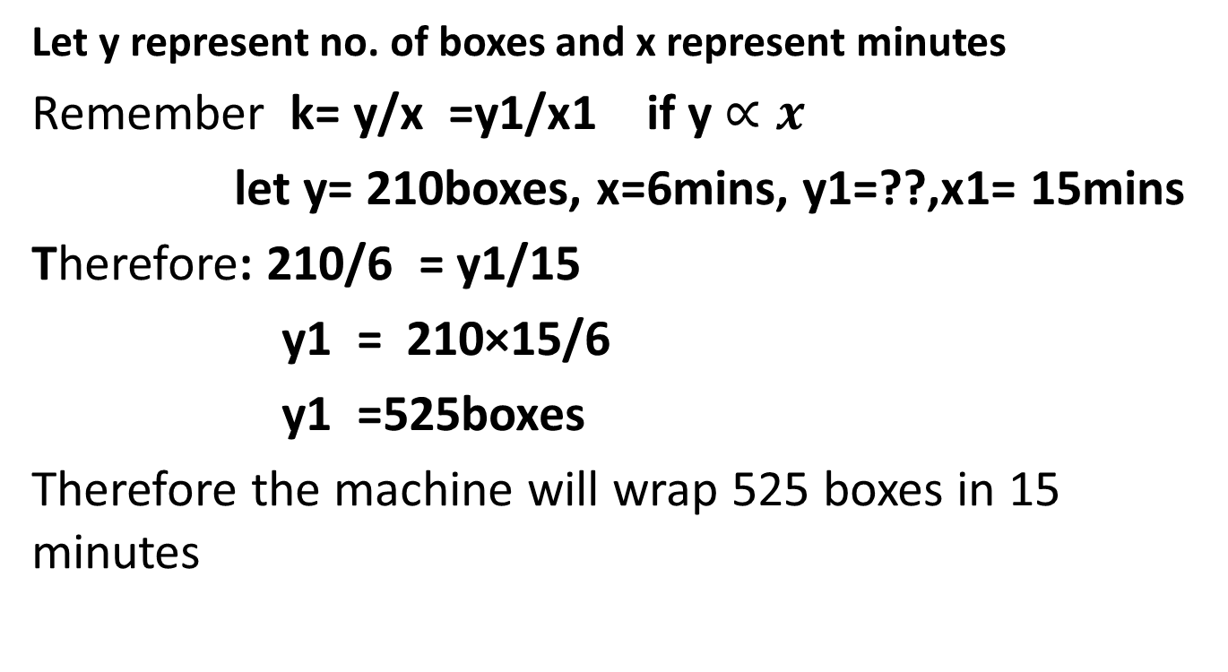
Qn 3 A packaging machine wraps 210 boxes in 6 minutes, how many boxes will it wrap in 15minutes at the same speed.
Let y represent no. of boxes and x represent minutes
Remember k= y/x =y1/x1 if y $∝x$
let y= 210boxes, x=6mins, y1=??,x1= 15mins
Therefore: 210/6 = y1/15
y1 = 210×15/6
y1 =525boxes
Therefore the machine will wrap 525 boxes in 15 minutes

Slide 7
Indirect proportion
Indirect proportion (also called inverse proportion) is a relationship between two quantities where when one quantity increases, the other decreases, and vice versa.
Consider two items y and x where y is indirectly proportional to x
Therefore we state y α 1/x removing the proportionality sign it becomes y = k(1/x)
y = k/x
k = xy = x1y1

Slide 8
Qn 1. It takes 8 builders exactly 6 days to paint a school building . How many days would it take 12 builders at the same pace?
Remember k = xy = x1y1 if we are doing the same thing( painting a building) at the same pace but different no. of builders.
Let y =8 builders, x= 6days and y1=12builders, x1=??
6×8 = 12×x1
x1 = 6×8/12
x1 =4 days

Slide 9
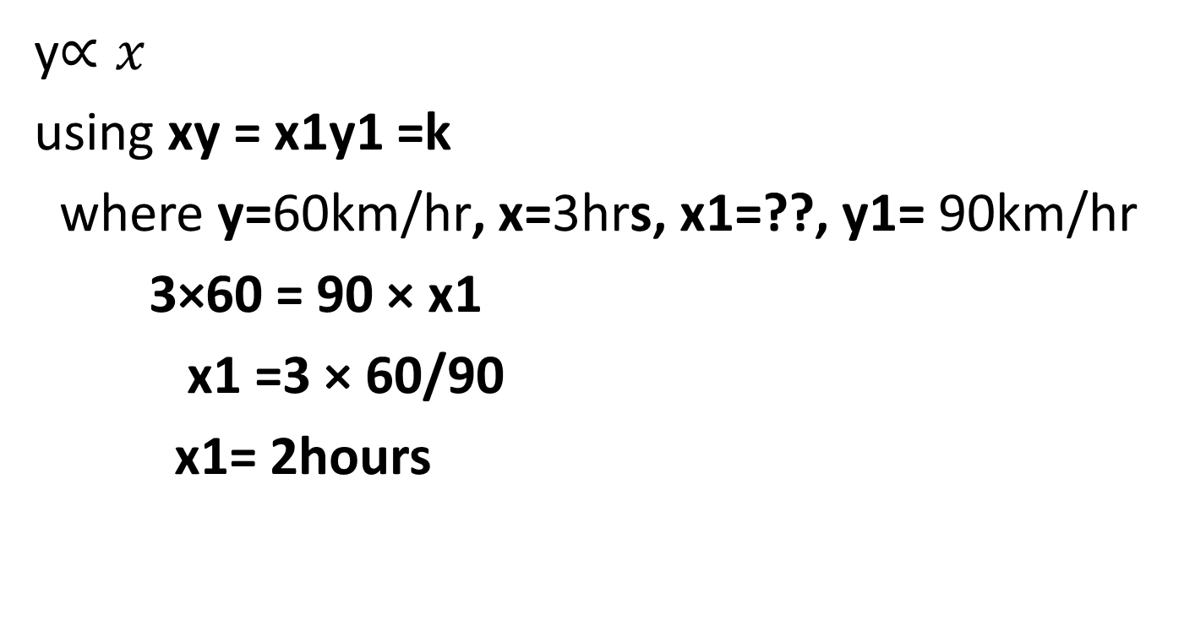
Qn.2 A delivery track travels 60km/hr and takes 3 hours. How long will it take at 90km/hr?
y$∝x$
using xy = x1y1 =k
where y=60km/hr, x=3hrs, x1=??, y1= 90km/hr
3×60 = 90 × x1
x1 =3 × 60/90
x1= 2hours

Slide 10
Qn.3 A poultry farmer has enough feed for 200 chicken for 15 days. After selling some birds 150 chicken remain, How many days will the feed last.
Using xy = x1y1
where y=200chicken, x=15days, y1=150 chicken, x1=??
15×200 = 150×x1
x1= 15×200/150
x1= 20days

Slide 11
RATIOS
REMEMBER: a ratio is a mathematical comparison between two or more quantities to show how one much one is, compared to the other.
For example the ratio of boys and girls in a class of 120 students is 1:2 this means that in this class 1/3 of 120 students are boys and 2/3 of the 120 are boys.
Qn1. two business partners sarah and john, split monthly profits in the ratio of 3:2. total profit= ugx 1,500,000. how much does sarah receive ?
Total ratio = 3+2 =5
So sarah gets 3/5 of the total profit and John gets 2/5 of the total profit
This means for sarah =3/5 × 1,500,000
= ugx 900,00

Slide 12
Qn1. two business partners sarah and john, split monthly profits in the ratio of 3:2. total profit= ugx 1,500,000. how much does sarah receive ?
Total ratio = 3+2 =5
So sarah gets 3/5 of the total profit and John gets 2/5 of the total profit
This means that sarah = 3/5 × 1,500,000
= ugx 900,00

Slide 13
Qn2. Concrete I mixed using cement and sand in the ratio 1:4. if sand= 24kg, how much cement is needed?
Method 1
alternatively
Total ratio= 1+4= 5
Cement= 1/5 and sand= 4/5
Let the total weight of the mixture be x
Therefore sand= 4/5 × x =24
x= 24×5/4
x= 30kgs
For cement 1/5 × 30
= 6kg.
We compare the ratio give with the ratio of the the weights which must be the same, cement : sand
1 : 4
c : 24
c being the weight of cement
Therefore; ¼ = c/24
c = 6kgs

Slide 14
Qn.3 A school field has width 800m and length 1.2 km find the ratio of width to length in the simplest whole numbers.
A school field has width 800m and length 1.2 km find the ratio of width to length in the simplest whole numbers.
Convert 1.2 km to meters
1km=1000m
1.2km=1.2×1000
=1200m
Find the ratio
800:1200
2:3 (This is got by dividing the distances by 400)

Slide 15
note
For proportions first find out whether you are dealing with direct or indirect and the start computing.
For ratios note they can be expressed as fractions.
the end

